Slide 1

RNA-SEQ analysis Pipeline
Kelly J. Cardona L
ID:178554

Slide 2
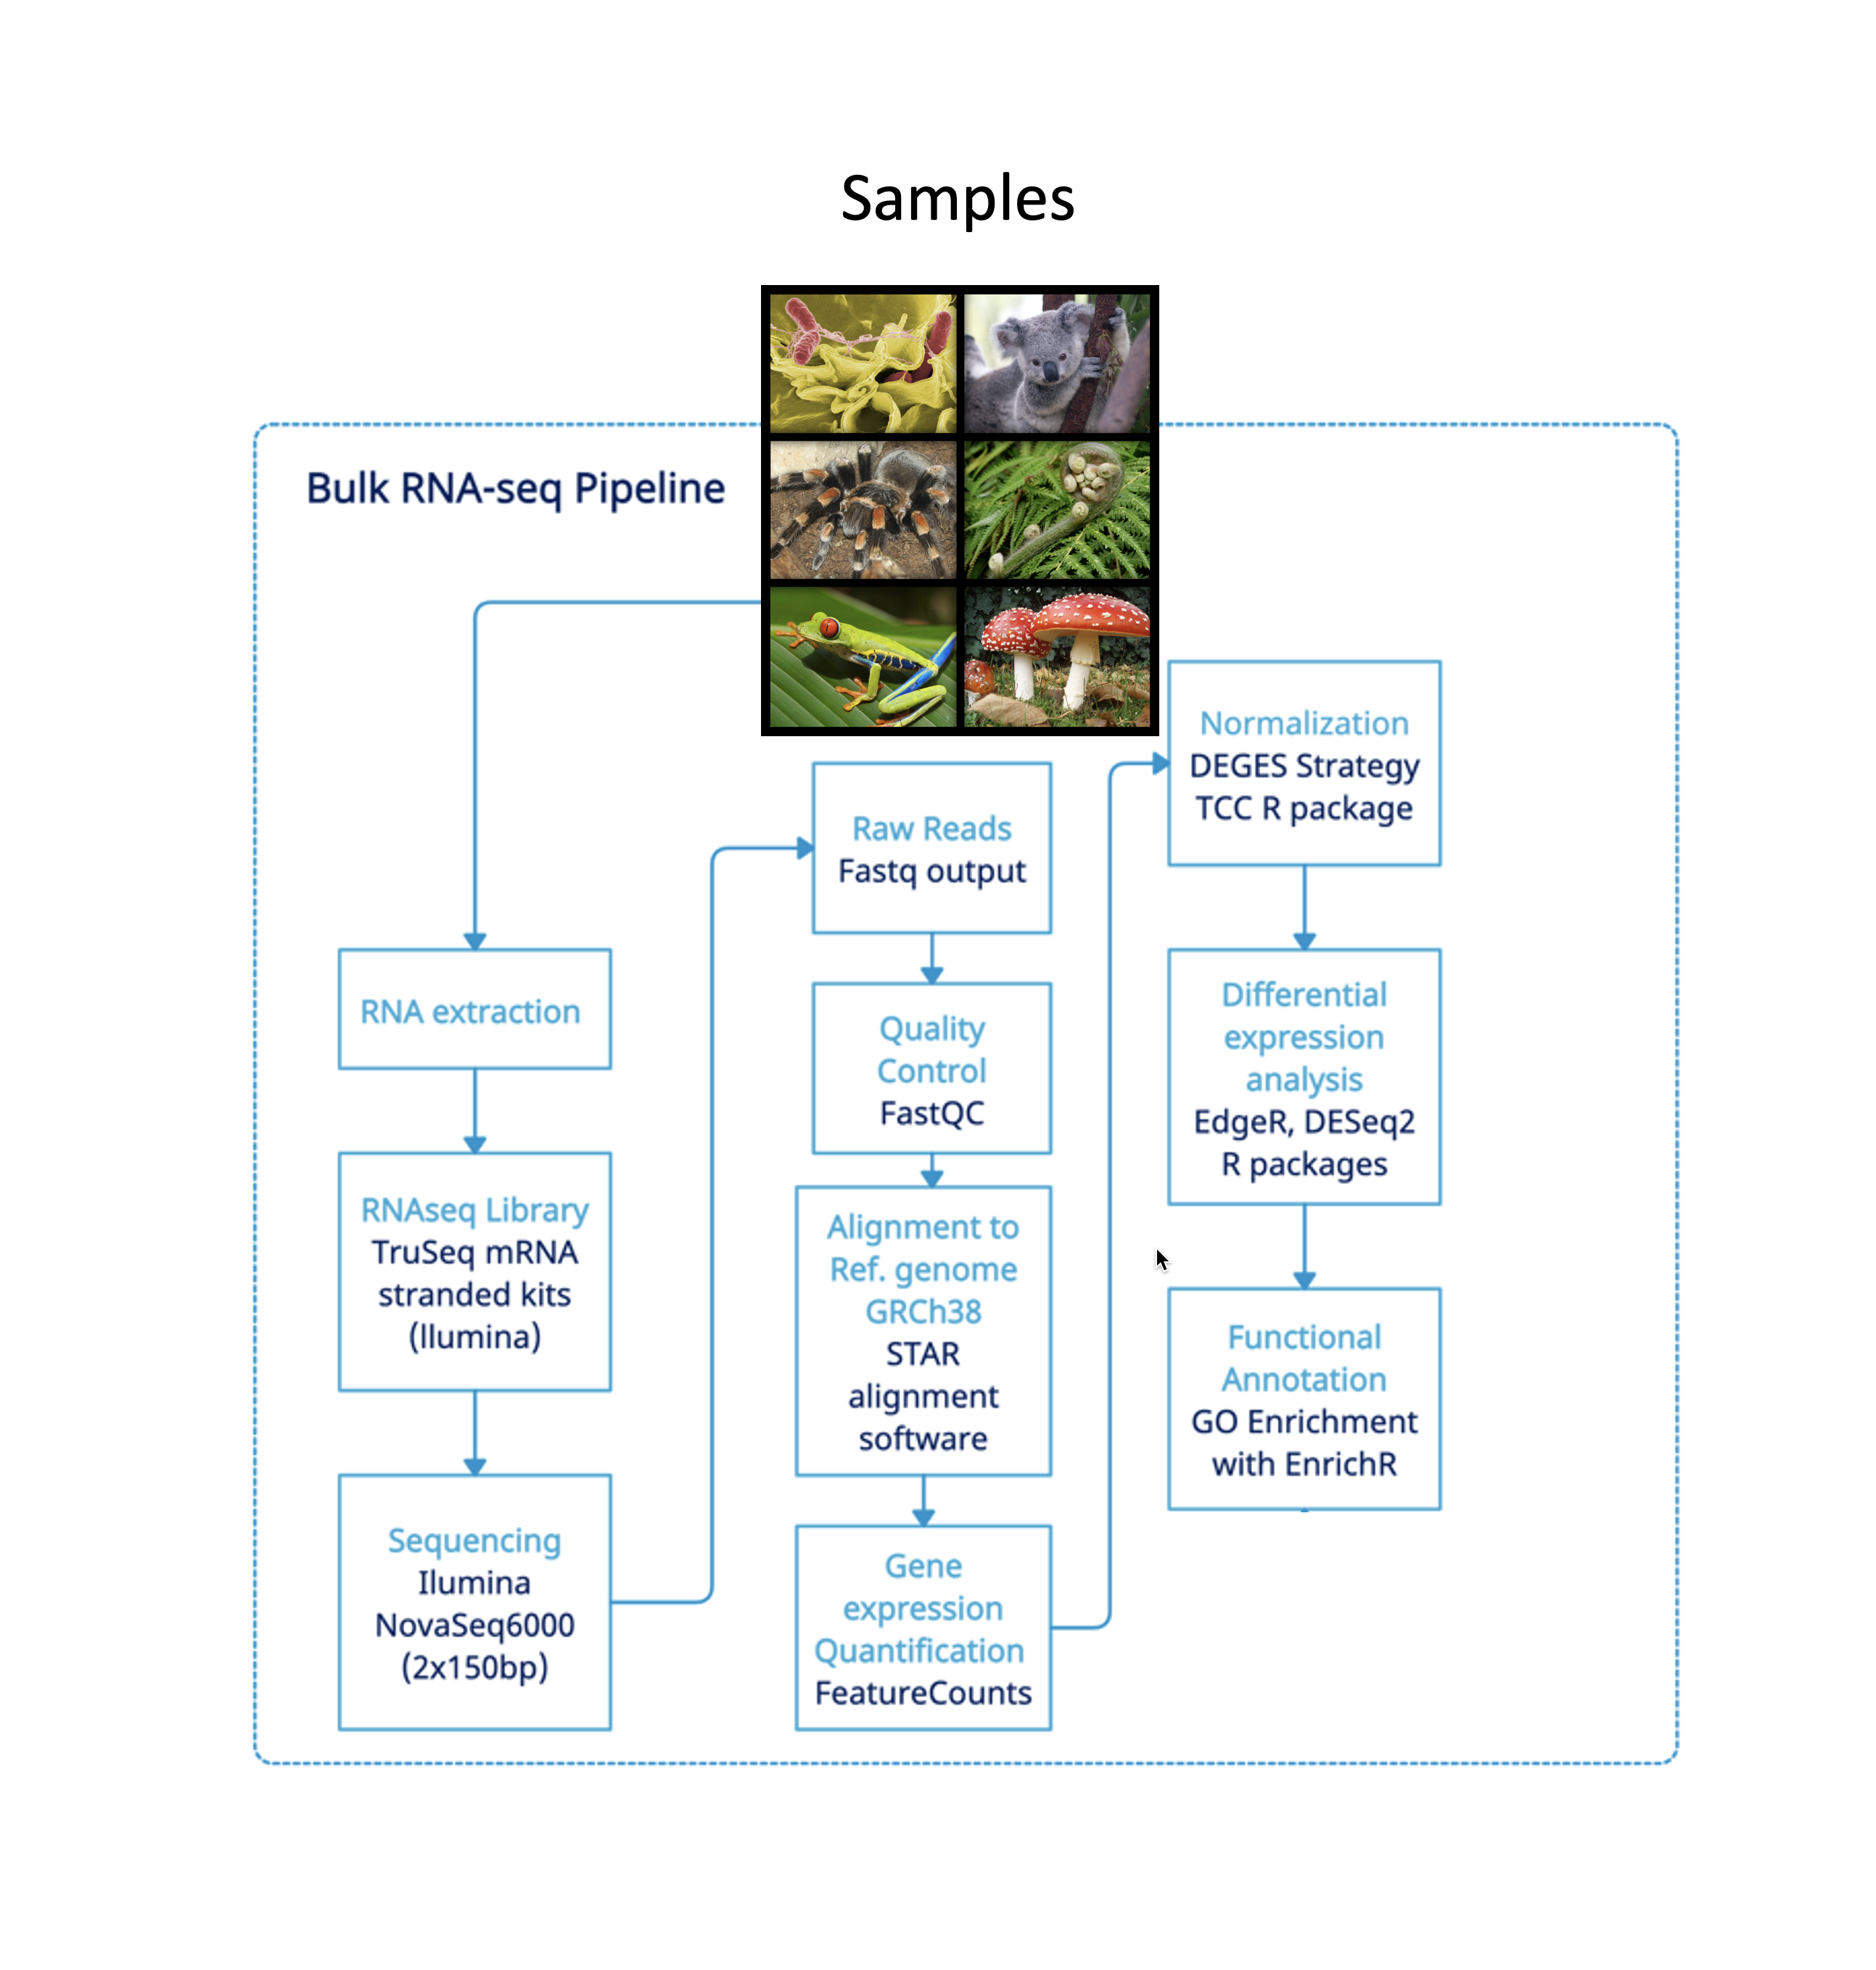
Steps!
0. Be prepared
Get the raw data
Get the metadata (collect biological and technical data, as much as possible, to describe you experiment in an objective way so you can account for any covariate that could bias your results.)
Get reference genome/transcriptome (use proper version, for long term studies try to maintain the genome version stable) and buid index.
QC control & trimming (if needed)
Do a quality control on your data once you receive it and make adjustments if necessary
Mapping
Map reads to references
Keep in mind your biological question to know how to adjust your parameters.
Generate your counts
DE analysis
Filter your low counts, correct for batch of covariates (if needed)
Perform your DE analysis and select your thresholds for significance according to your biological question
*The tools are ilustrative, the selection of tools depends on the specific biological question and data available.
4. Functional Annotation
It depends a lot on the biological question and findings from the DE

Slide 3
My example

Slide 4

Step 0. Be prepared
paired-end 150 bp sequenced with Illumina NovaSeq6000
hESC h1 (46,XY) S1 cultured in hypoxia & S2 in normoxia
Two Samples:
M-19-4853_2243_AD010_L002_R1_001.fastq
M-19-4853_2243_AD010_L002_R2_001.fastq
M-19-4854_2244_AD011_L002_R1_001.fastq
M-19-4854_2244_AD011_L002_R2_001.fastq
S1
S2
NOTICE: this is not a “real” dataset. Are only two samples randomly selected from
my lab for illustrative purposes.

Slide 5
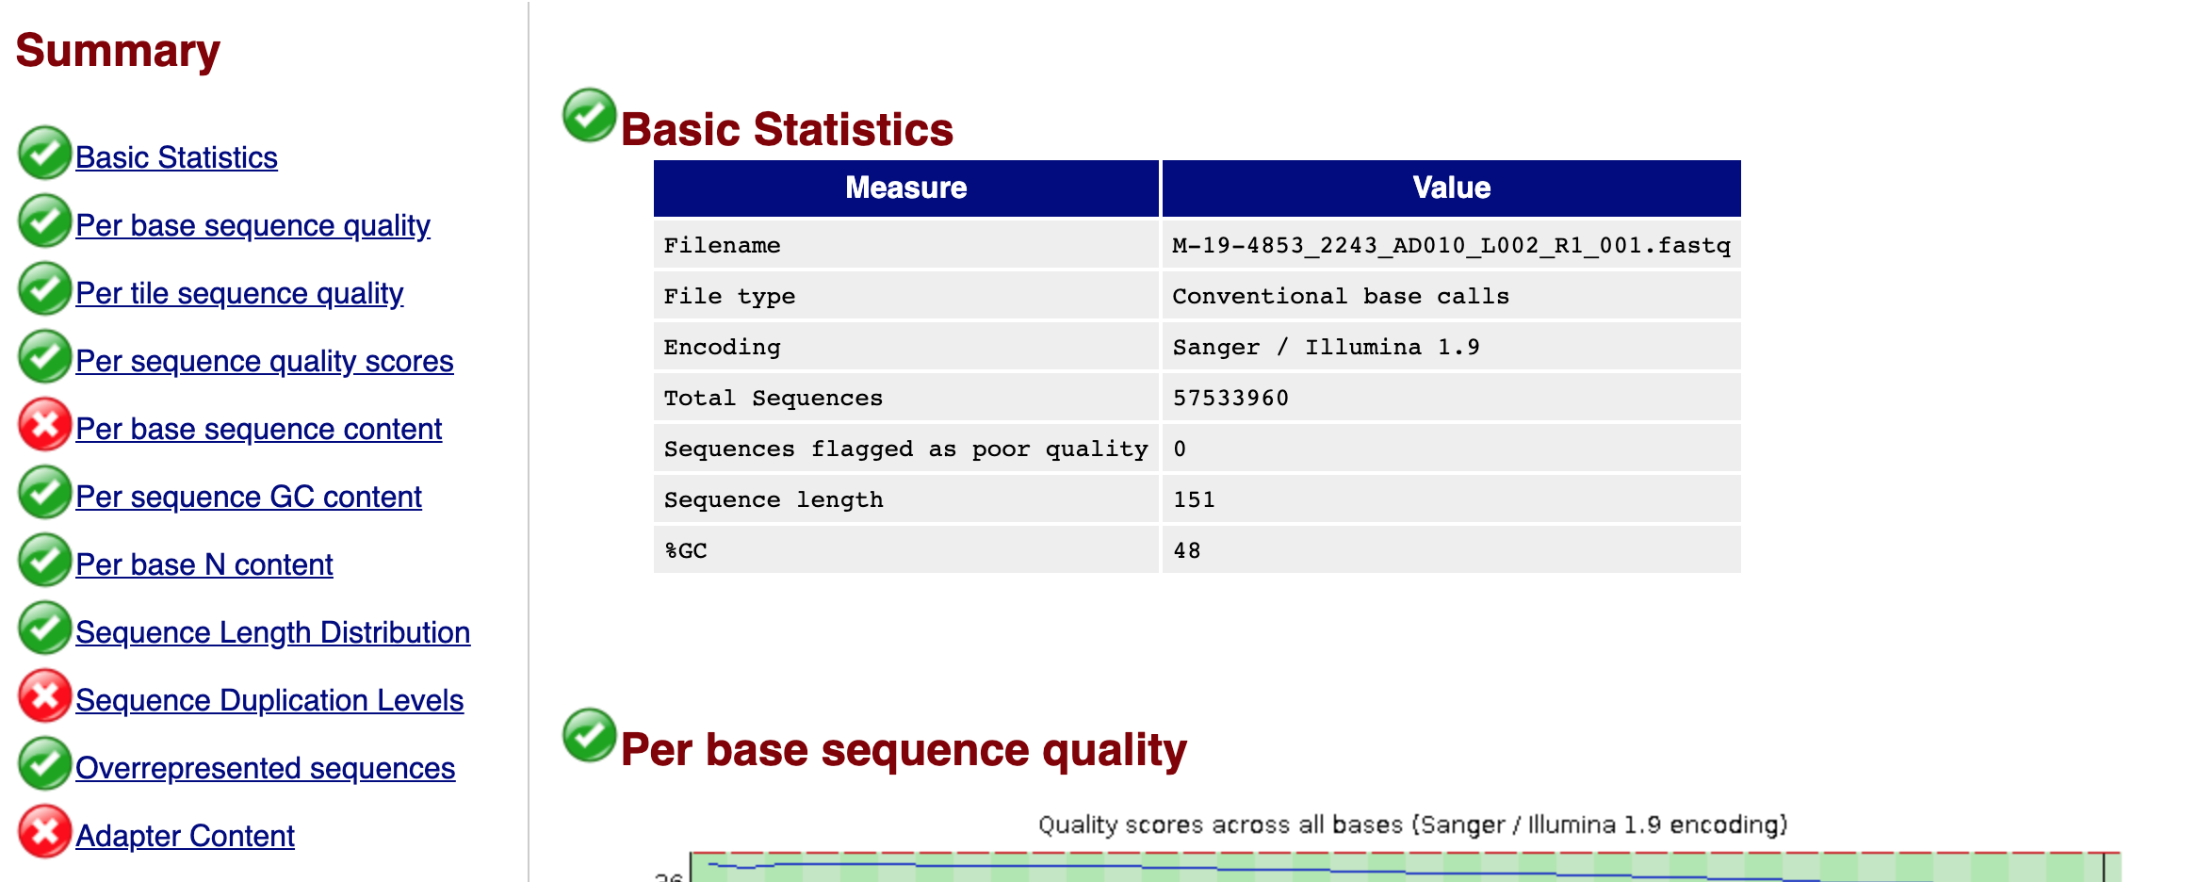
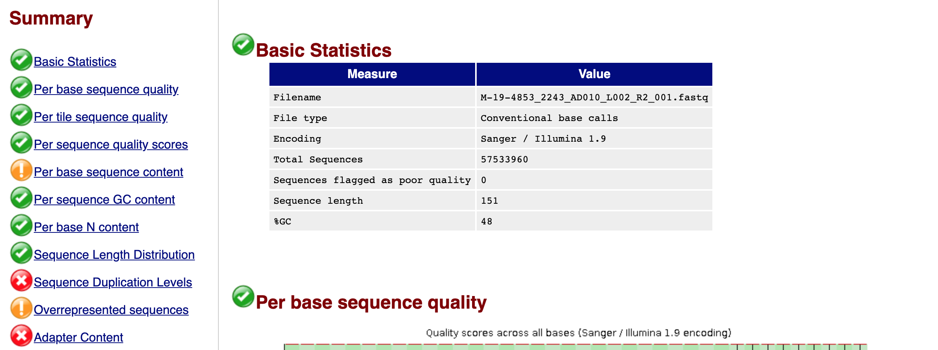
1. QC Control & Trimming (if needed)
Initial Quality Analysis – FastQC (S1 – Raw)

Slide 6
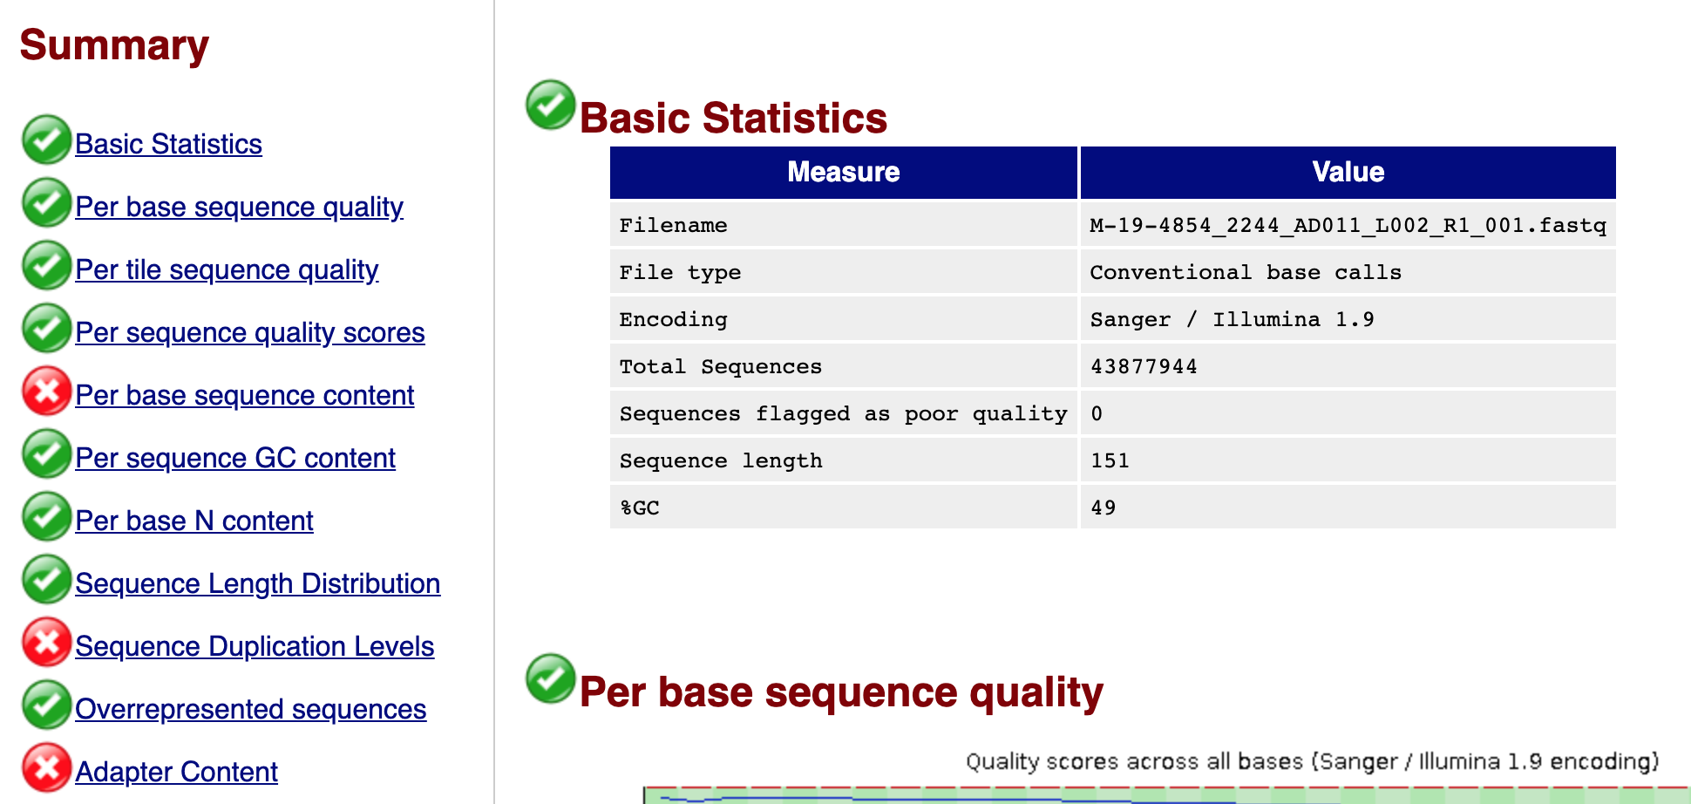
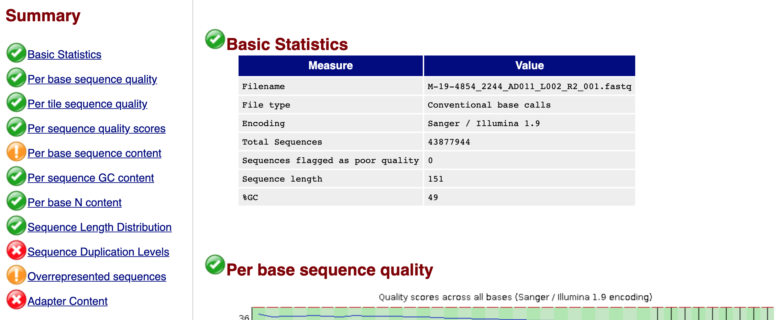
1. QC Control & Trimming (if needed)
Initial Quality Analysis – FastQC (S2 – Raw)
We have adapters and dups. We need to trimm!

Slide 7
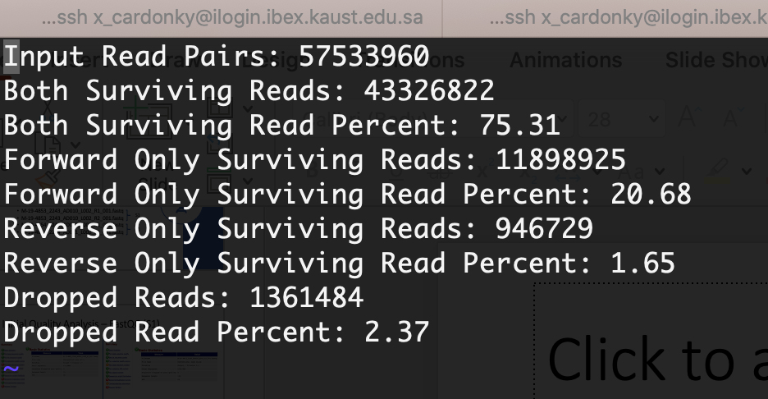

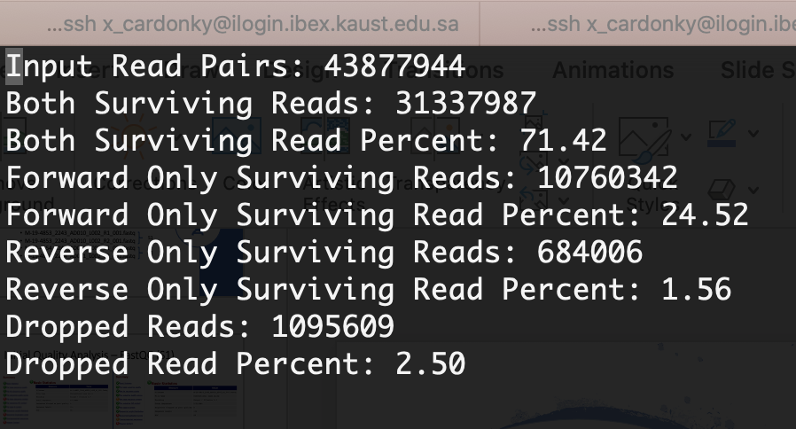
Trimming and quality control
S1
Alternative approach: Trimommatic
remove adapters, trimming considering a minimum read length of 35 bp and a minimum Phred-quality score of 25
S2

Slide 8
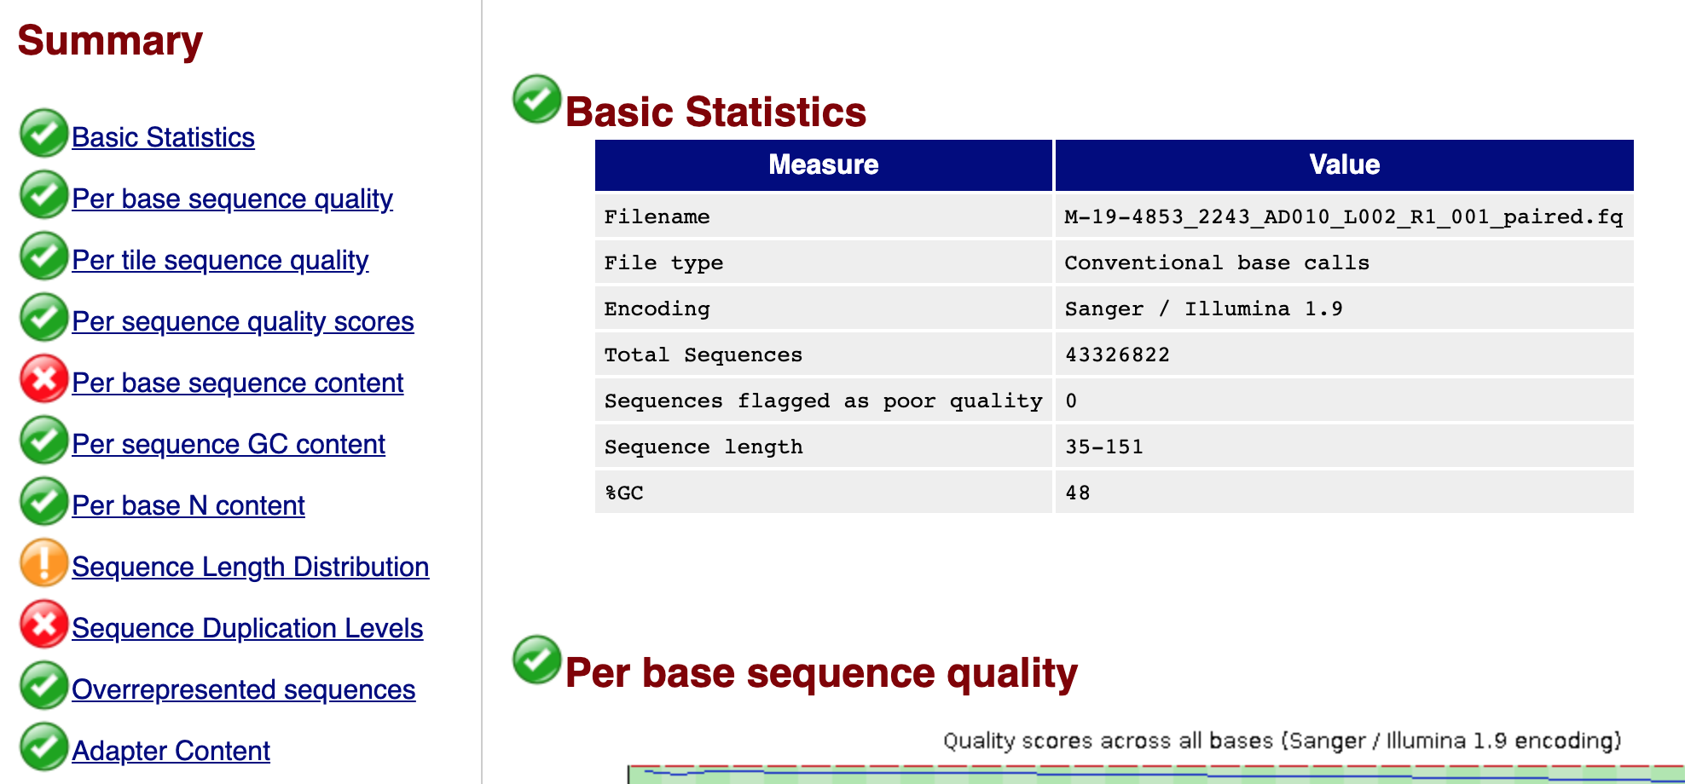
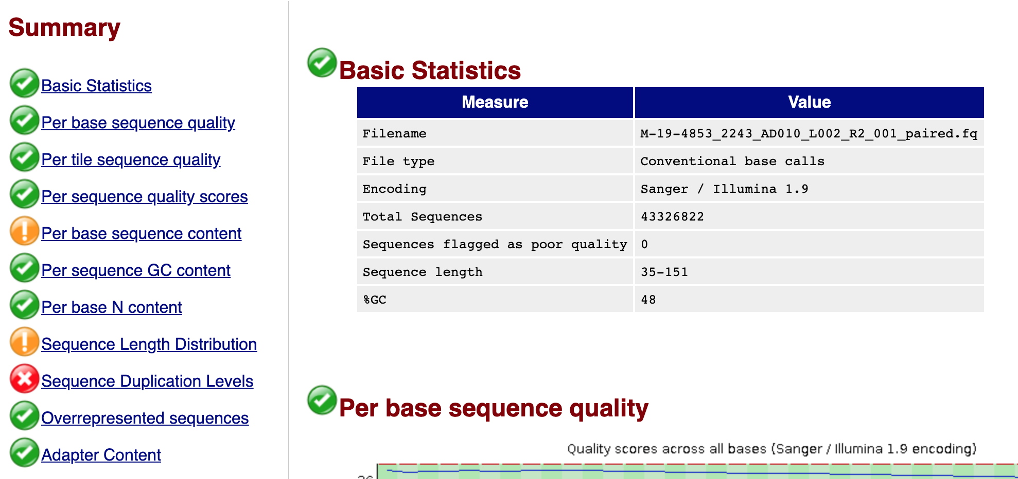
Quality after Trimming (Sample S1)
BEFORE
AFTER

Slide 9
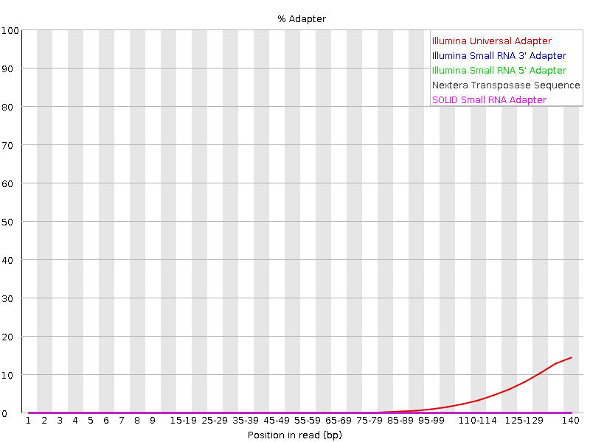

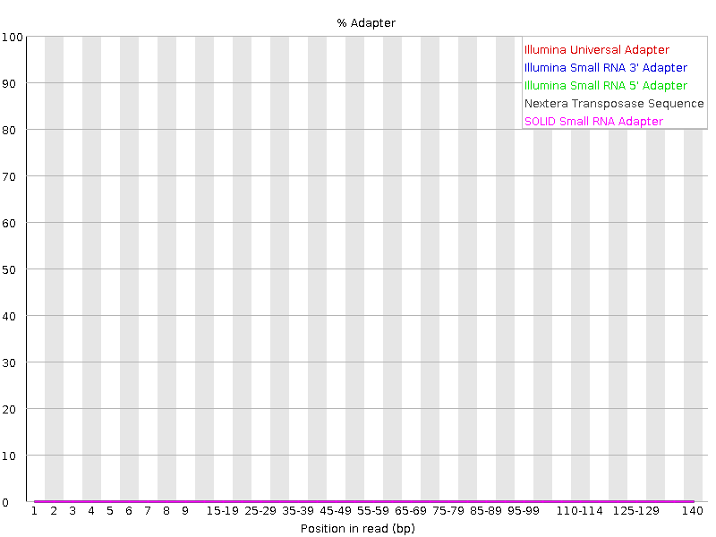
Quality after Trimming (S1) - Adapters
BEFORE
M-19-4853_2243_AD010_L002_R1_001.fastq
M-19-4853_2243_AD010_L002_R2_001.fastq
AFTER
M-19-4853_2243_AD010_L002_R1_001.fastq
M-19-4853_2243_AD010_L002_R2_001.fastq

Slide 10
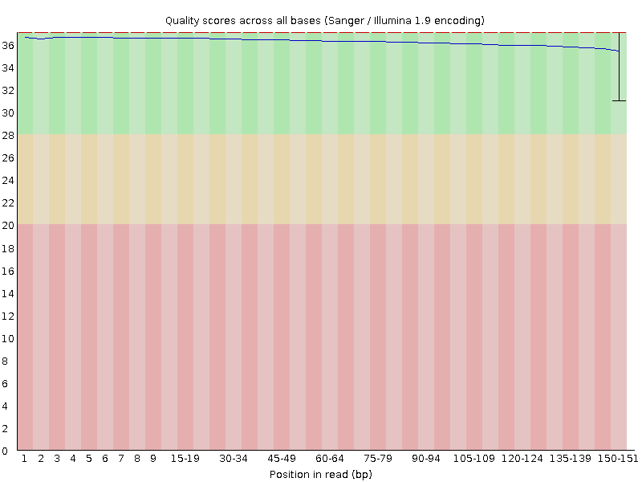
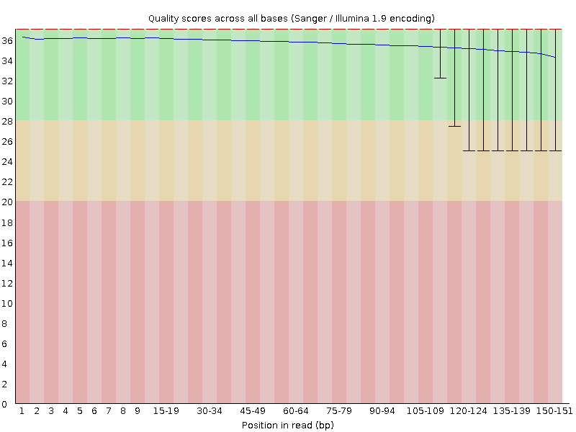
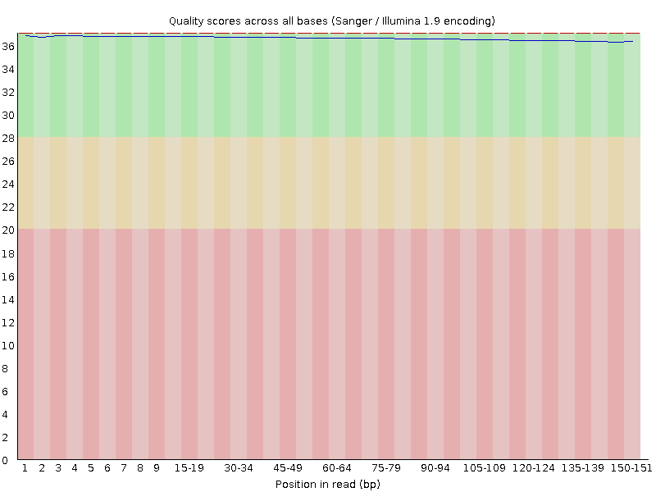
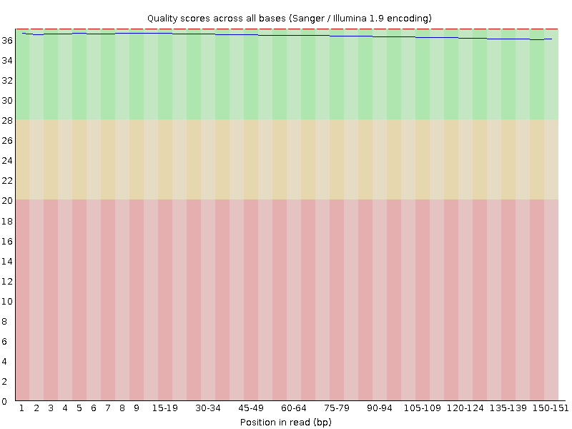
Quality after Trimming (S1) – Reads Quality
BEFORE
M-19-4853_2243_AD010_L002_R1_001.fastq
M-19-4853_2243_AD010_L002_R2_001.fastq
AFTER
M-19-4853_2243_AD010_L002_R1_001.fastq
M-19-4853_2243_AD010_L002_R2_001.fastq

Slide 11
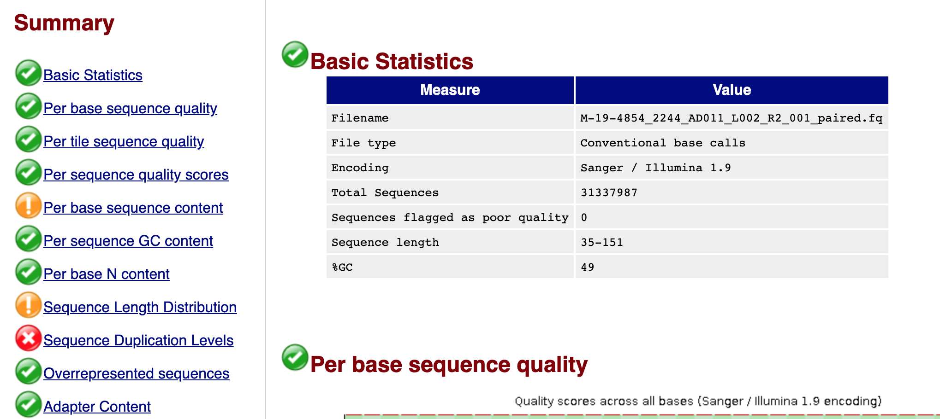
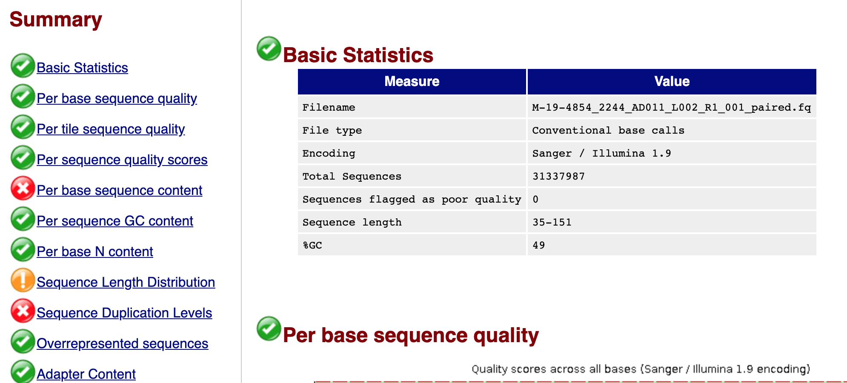
Quality after Trimming (S2)
BEFORE
AFTER

Slide 12
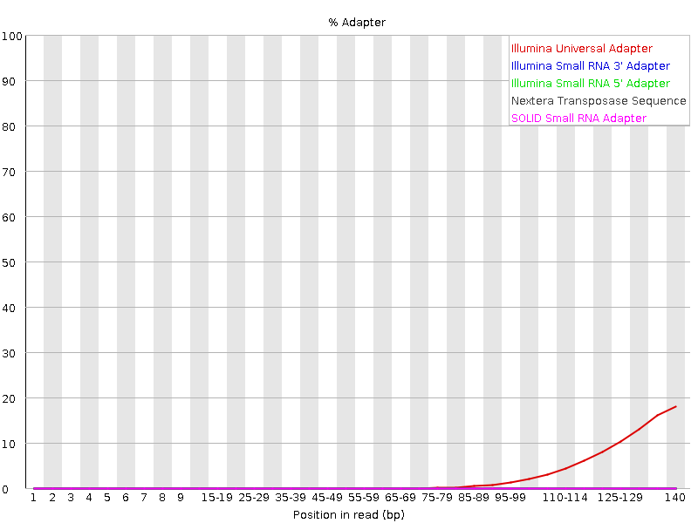

Quality after Trimming (S2) - Adapters
BEFORE
M-19-4854_2244_AD011_L002_R1_001.fastq
M-19-4854_2244_AD011_L002_R2_001.fastq
AFTER
M-19-4854_2244_AD011_L002_R1_001.fastq
M-19-4854_2244_AD011_L002_R2_001.fastq

Slide 13

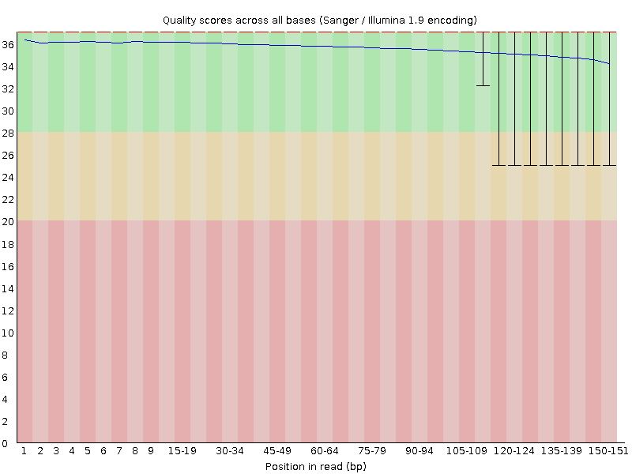
Quality after Trimming (S1) – Reads Quality
BEFORE
M-19-4854_2244_AD011_L002_R1_001.fastq
M-19-4854_2244_AD011_L002_R2_001.fastq
AFTER
M-19-4854_2244_AD011_L002_R1_001.fastq
M-19-4854_2244_AD011_L002_R2_001.fastq

Slide 14


There is still something wrong (or maybe not)
“In RNA-Seq libraries sequences from different transcripts will be present at wildly different levels in the starting population. In order to be able to observe lowly expressed transcripts it is therefore common to greatly over sequence high expressed transcripts, and this will potentially create large set of duplicates. This will result in high overall duplication in this test, and will often produce peaks in the higher duplication bins. This duplication will come from physically connected regions, and an examination of the distribution of duplicates in a specific genomic region will allow the distinction between over-sequencing and general technical duplication, but these distinctions are not possible from raw fastq files”. FastQC Documentation - Duplicate Sequences module

Slide 15
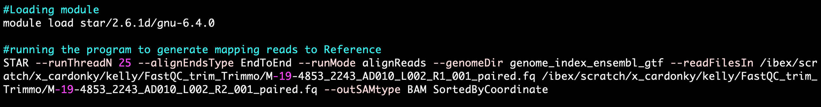
2. Mapping
Reference Genome: GRCh38/Ensembl release 101
Reference Annotation: GRCh.38.101.gtf
Tool: STAR using end-to-end alignment method
Ran on IBEX

Slide 16
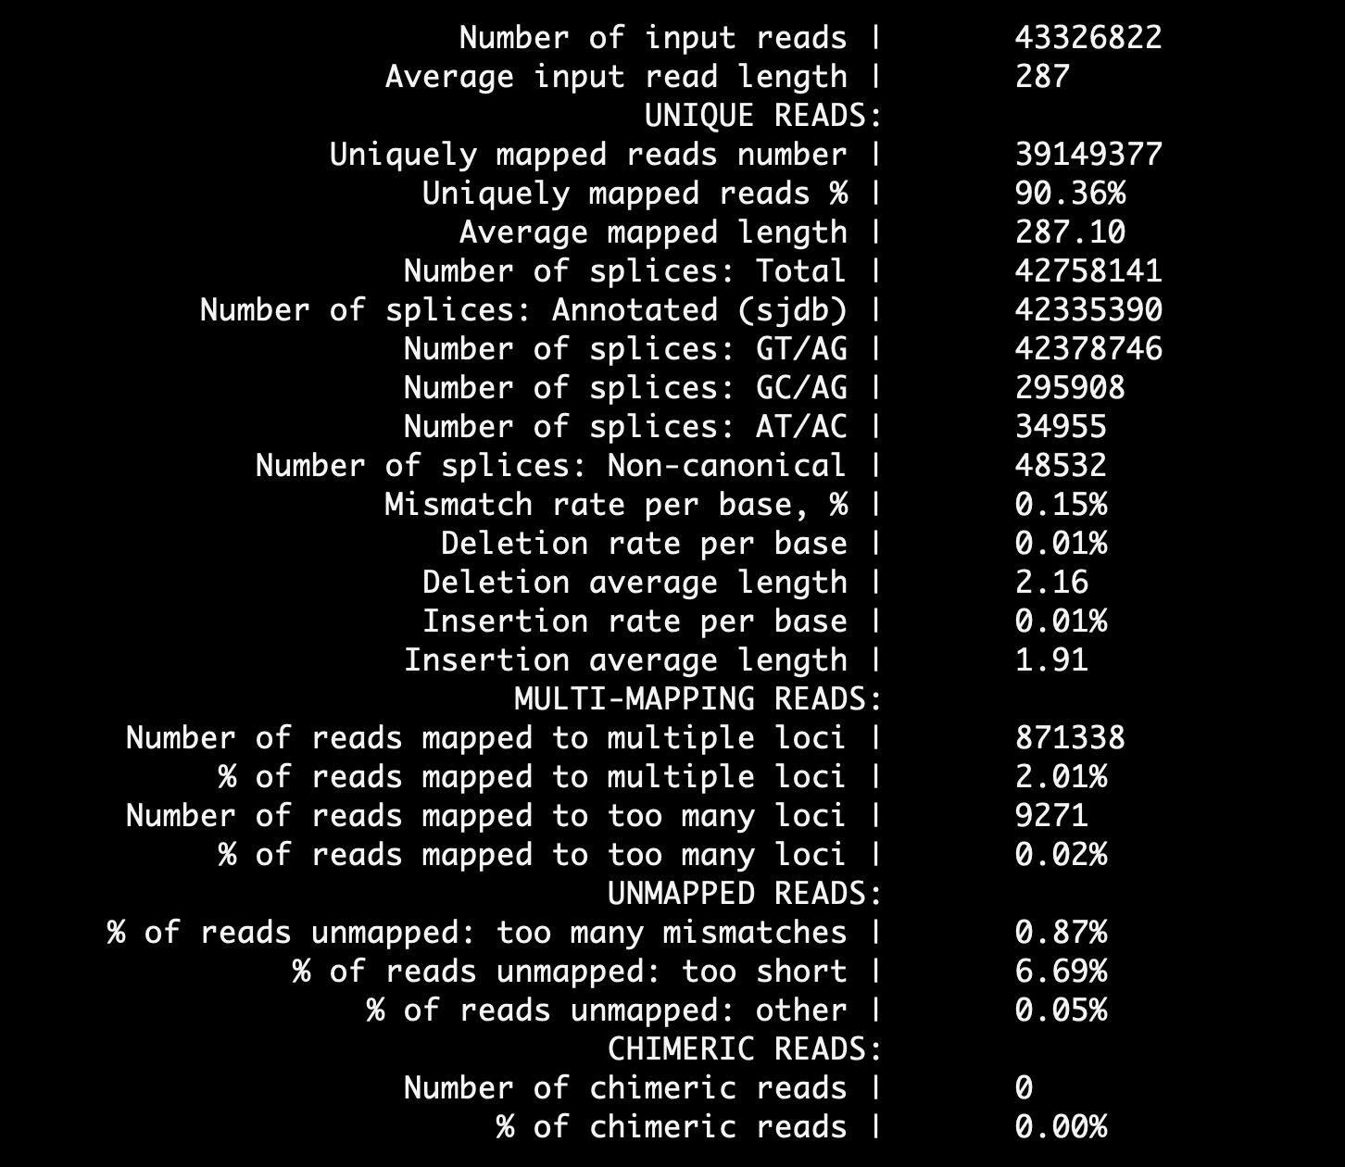
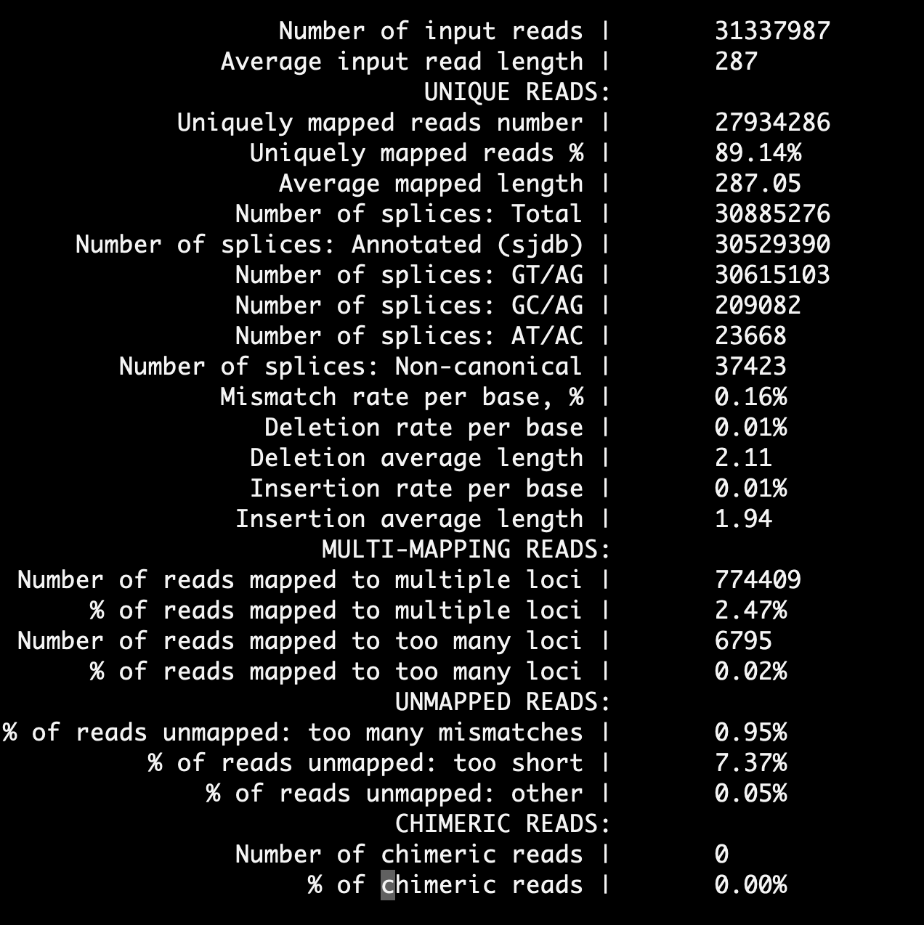
2. Mapping
M-19-4853_2243_AD010_L002_001.bam
M-19-4854_2244_AD011_L002_001.bam

Slide 17
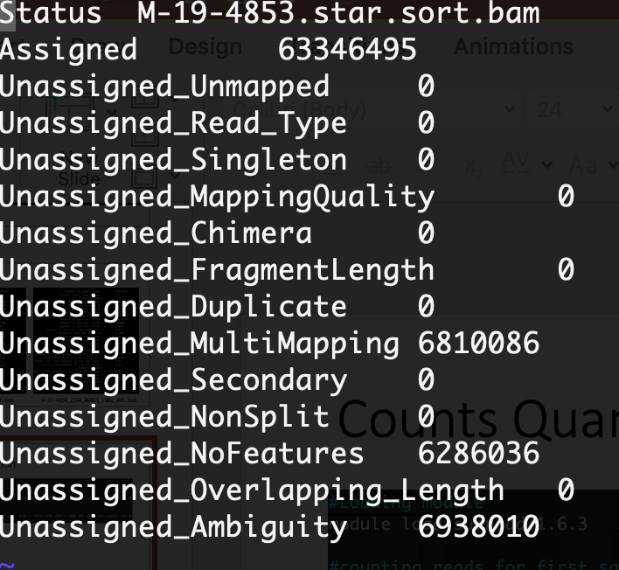
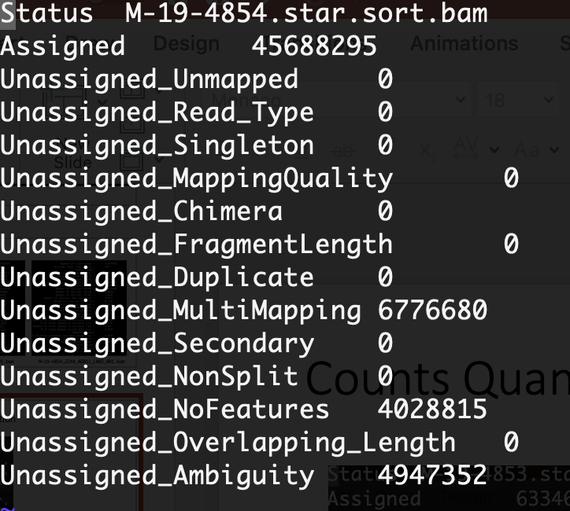
2. Mapping – reads quantification
M-19-4853_2243_AD010_L002_001.bam
M-19-4854_2244_AD011_L002_001.bam

Slide 18
3. DEG Analysis
EdgeR package from R.
Data normalization with the TMM model
DEG selection criteria: FDR<0.05 and LogFC >|0.25|
Replicates are strongly necessary for DEG analysis!. For this example, a duplication of each sample was applied to develop further analysis. However, the next results are merely a technical approximation and do not reflect a realistic biological context.

Slide 19
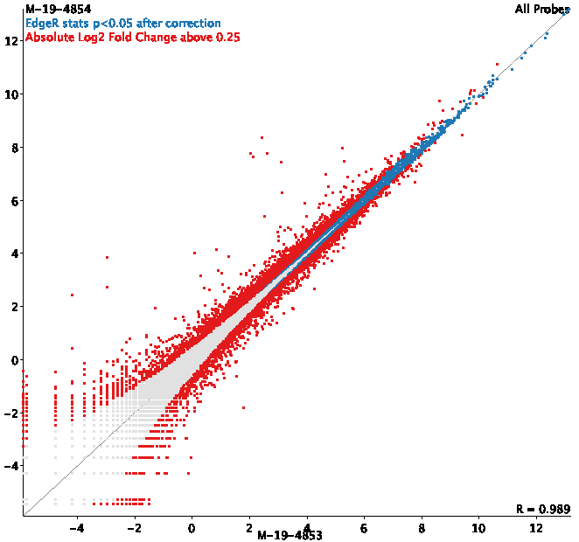
Scatter plot for DEG genes
Upregulated Genes | 3124
Downregulated Genes | 2338
Total | 5462
FDR<0.05 and LogFC =|0.25|

Slide 20
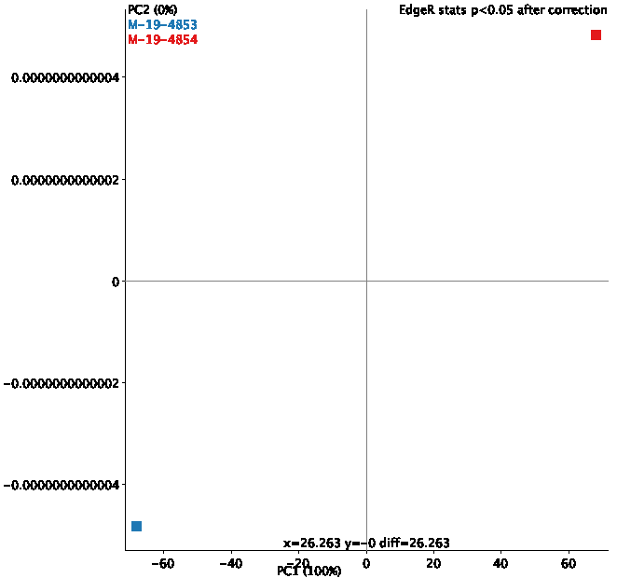
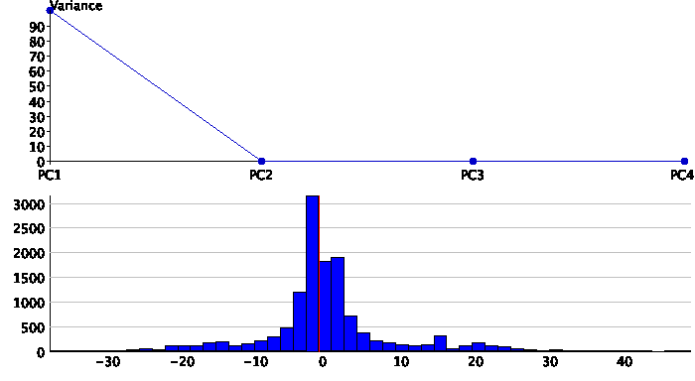
DEG Analysis – PCA
normalization with TMM model

Slide 21
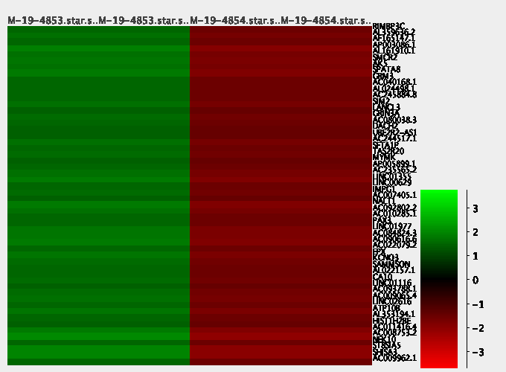
Heatmap of a subset genes with the highest variance according to PCA analysis

Slide 22
4. Functional Annotation
Using EnrichR for terms associated with GO: biological process
Bonferroni test was conducted to correct P values < 0.05.
5462 DEG (p-value <0,05, FDR<0.05 and LogFC =|0.25|) Segregating genes in upregulated and downregulated

Slide 23
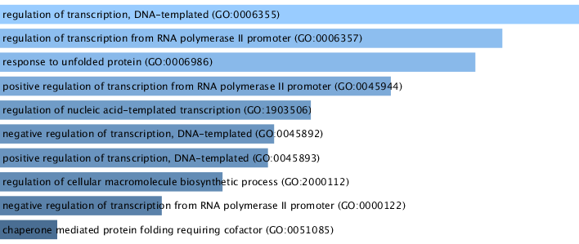
Enrichment analysis for Upregulated genes GO: Biological processes

Slide 24
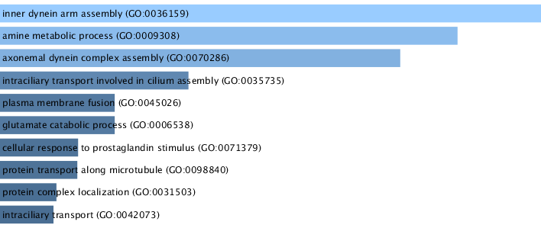
Enrichment analysis for Downregulated genes GO:Biological processes

